Slide 1
BASIC R
APP-BIOINFO-2024 R SERIES
Duy Dao
khuongduying@gmail.com
2024, Nov 23th

Slide 2
Content
Overview
Install R
Basic R
Data types and Structures
R Functions

Slide 3

Overview
What is R?
A Programming/Statistical Language
A powerful language for statistical computing and data analysis.
Widely used in bioinformatics and life sciences.

Slide 4
Why Use R for Bioinformatics Analysis?
Comprehensive Statistical Tools
Rich Ecosystem of Bioinformatics Packages
Data Visualization
Handling High-Dimensional Data
Open Source and Active Community
Reproducibility
Free

Slide 5
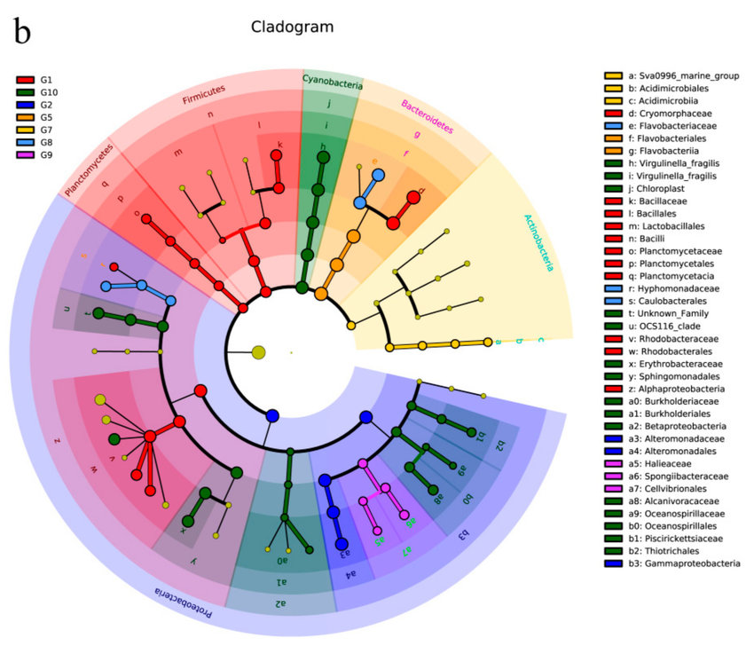
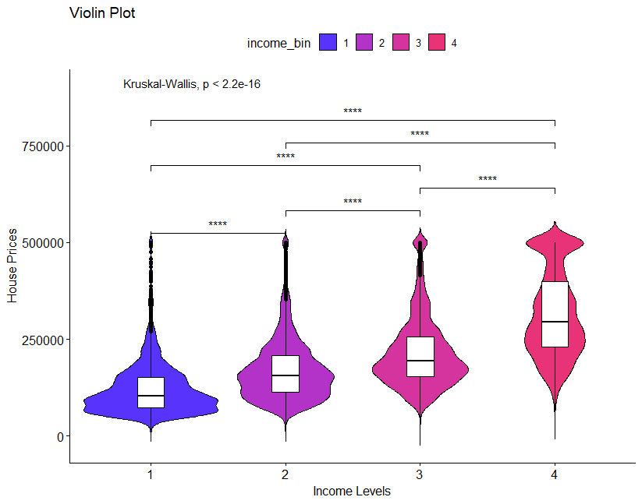
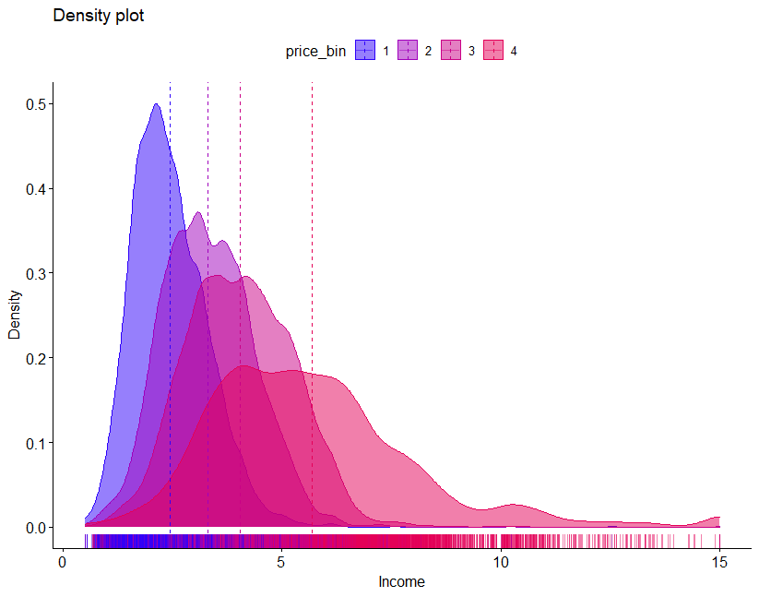
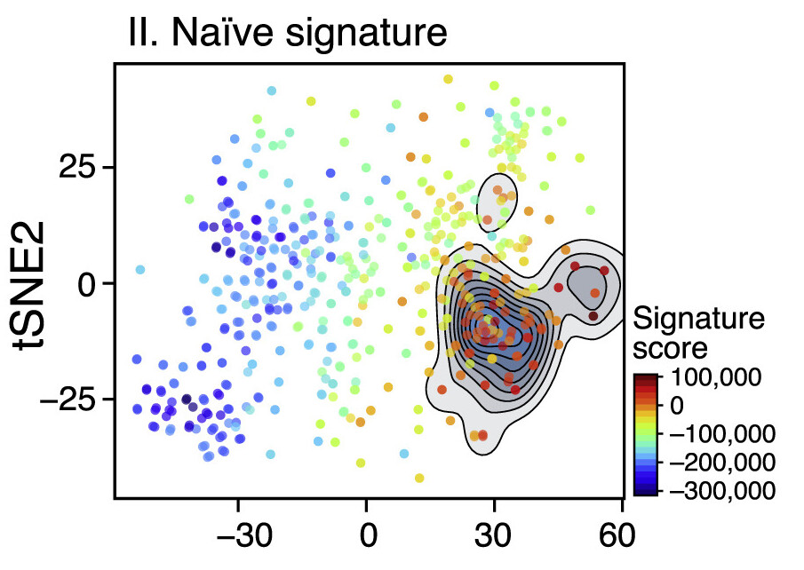
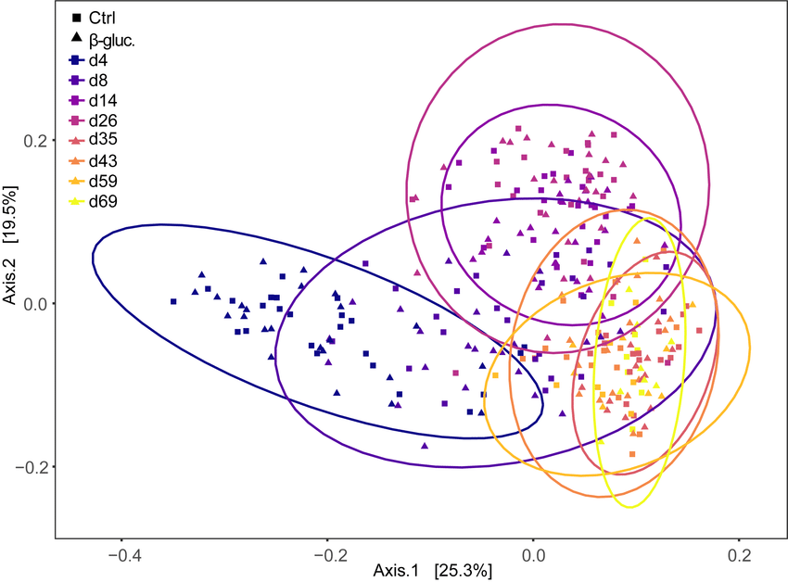
Why Use R for Bioinformatics Analysis?
Generation of publication-quality graphs and figures.

Slide 6
Install R

Slide 7
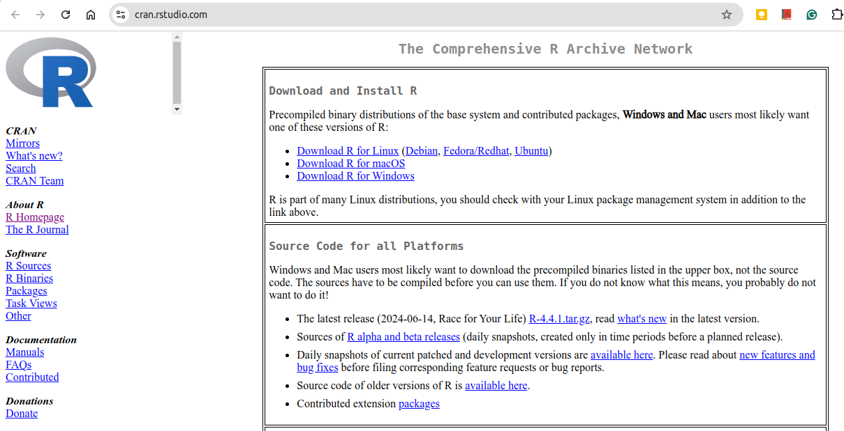
Install R
Install R by accessing to this R’s original website
https://cran.rstudio.com/

Slide 8
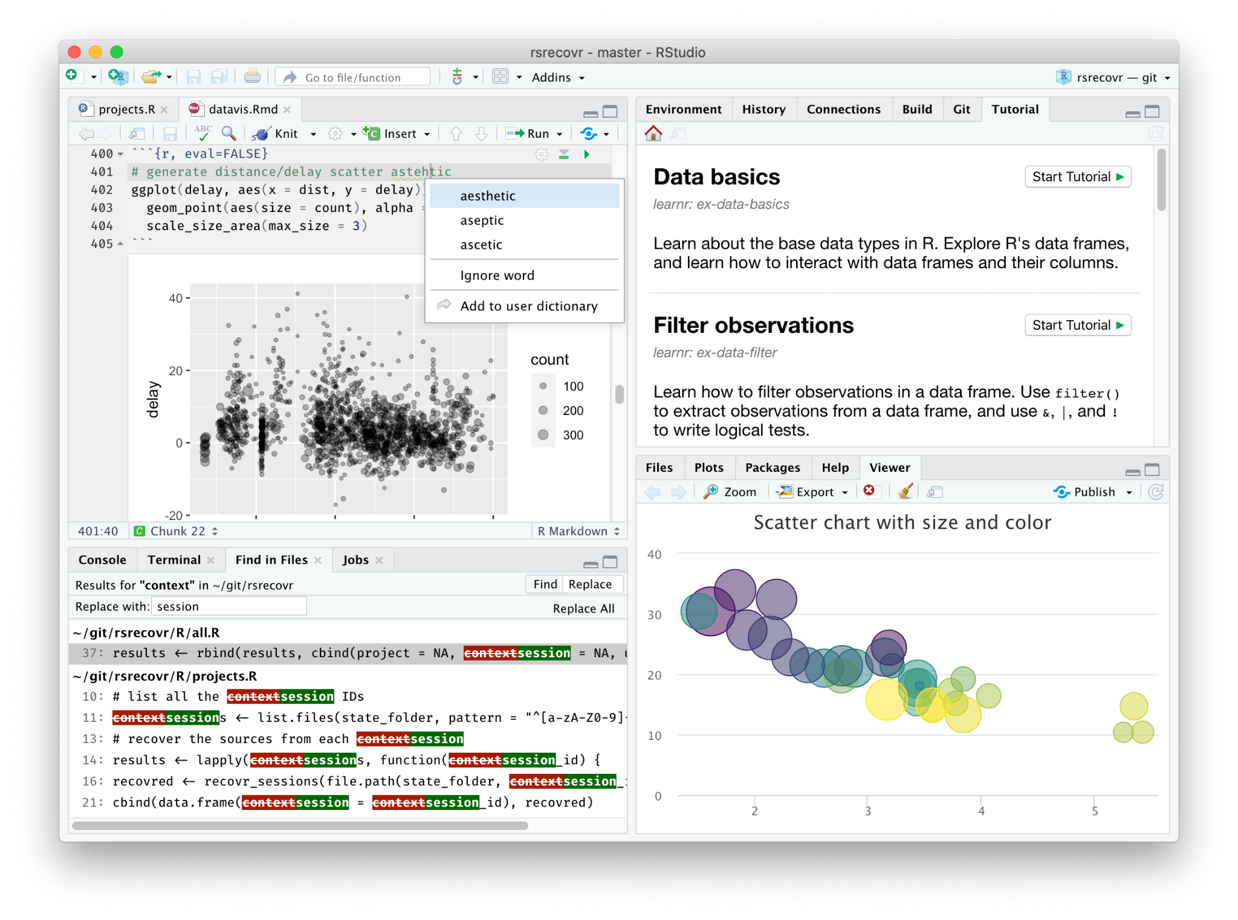

R and RStudio
R Studio IDE (Integrated development environment - IDE)
Install: https://posit.co/download/rstudio-desktop/
Enhances productivity with features like syntax highlighting, debugging tools, and version control.

Slide 9
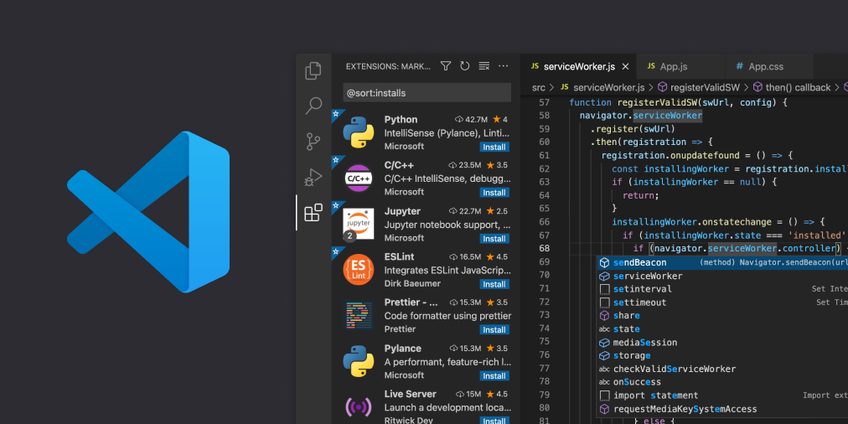
R and RStudio
Alternative IDE: VScode
Install: https://code.visualstudio.com/

Slide 10
First R

Slide 11
The R script
# Import library
library(ggpubr)
library(tidyverse)
library(plyr)
# Load data
data("ToothGrowth")
print(ToothGrowth)
# Error plots
# ggerrorplot()
# Mean +/- standard deviation
ggerrorplot(ToothGrowth,
x = "dose", y = "len",
desc_stat = "mean_sd")
Comments for each code block
Import libraries
Load data
Code to visualize the data

Slide 12
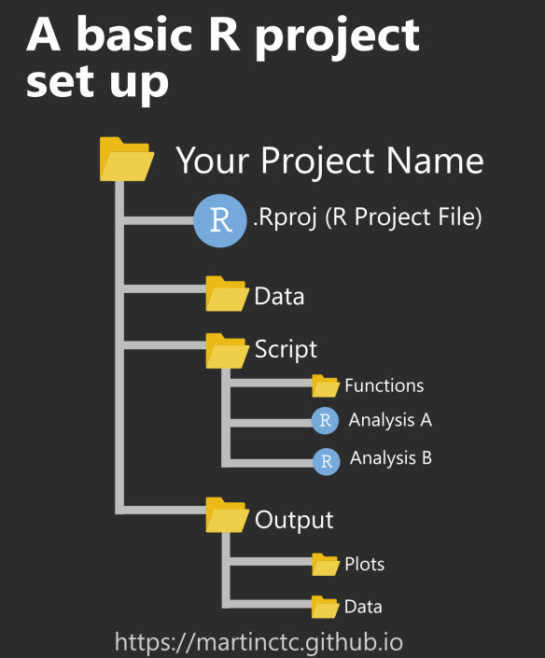
Working directories
Working Directory
The default folder where R looks for files to read and saves outputs.
It's essential to know and set your working directory for organized data analysis.
# First, have a look at the current working directory
getwd()
# Change to your desired directory
setwd()
# List the file in the directory
dir()
https://www.r-bloggers.com/2020/01/rstudio-projects-and-working-directories-a-beginners-guide/

Slide 13

Installing and Loading R Packages
R packages are extensions to the R statistical programming language.
R packages contain
code
data
documentation in a standardised collection format
can be installed by users of R, typically via a centralised software repository such as CRAN
https://roelverbelen.netlify.app/resources/r/packages/

Slide 14
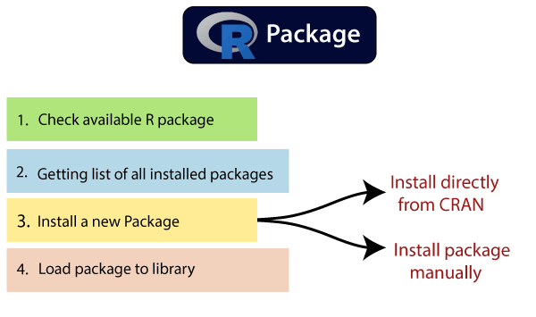
Installing and Loading R Packages
# Get the list of installed packages
installed.packages()
# Install package
install.packages()
# Import package
library()
# get all packages currently loaded in the R environment.
search()
# Check installed packages location
.libPaths()
# Update package
update.packages()
https://www.javatpoint.com/r-packages
Notes:
update.packages()

Slide 15
Classwork 1: Download packages
Search and download these packages:
tidyverse
readr

Slide 16

Help Files and Function Documentation
# Access the help file
?mean
# If unsure of the precise name
# search doc across all installed packages
??mean

Slide 17
Saving Work and Exiting R
An R workspace image contains all the information held in the R session at the time of exit and is saved as a .RData file
# Save current workspace
save.image(file="mysession.RData")
# exit R
q()
# Load workspace
load('myession.RData')

Slide 18
Basic R

Slide 19
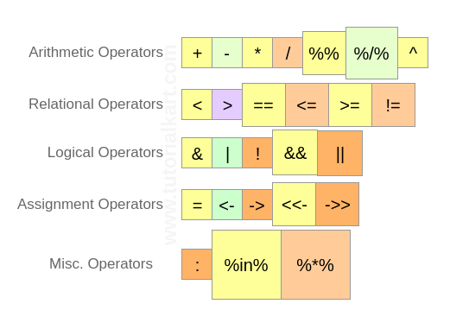
Operators in R
https://www.tutorialkart.com/r-tutorial/r-operators/#gsc.tab=0

Slide 20
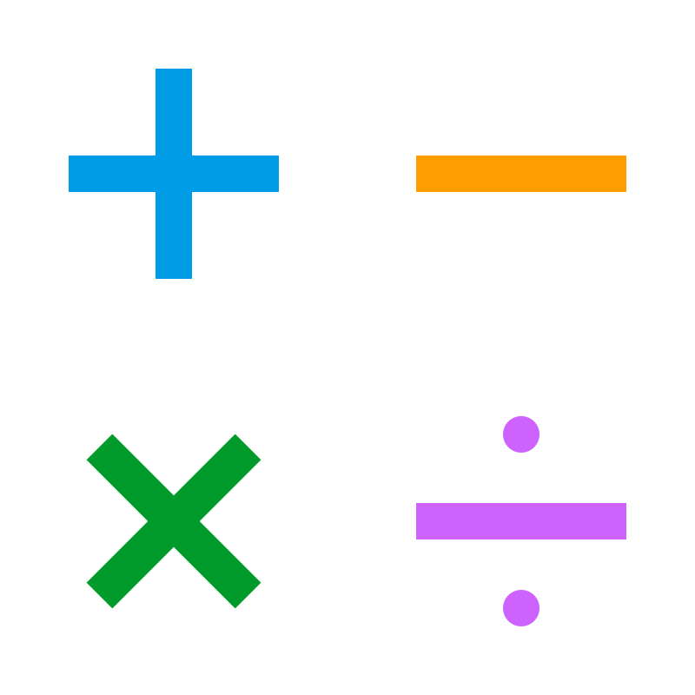
Operators in R
Arithmetic Operators
Logarithms and Exponentials
> log(10)
[1] 2.302585
> log10(10)
[1] 1
> exp(x=3)
[1] 20.08554
> sqrt(4)
[1] 2
> 1 + 3
[1] 4
> 1/2
[1] 0.5

Slide 21
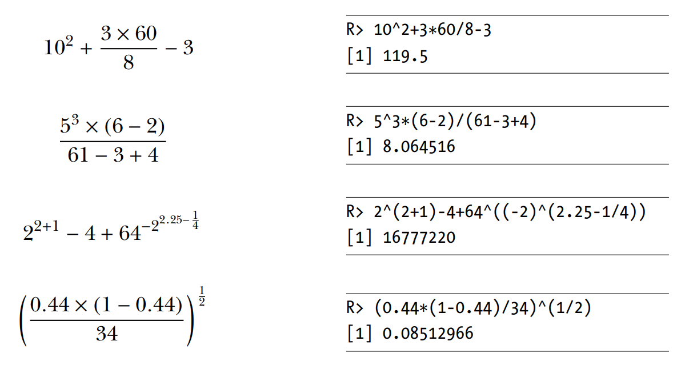
Operators in R
Arithmetic Operators
Performing calculation in R
Notes:
Order of Operations in R (PEMDAS/BODMAS)
Parentheses/Brackets: () - Expressions within parentheses or brackets are evaluated first.
Exponents/Orders: ^ - Exponentiation is evaluated next.
Multiplication and Division: *, / - These operations are evaluated from left to right.
Addition and Subtraction: +, - - These operations are evaluated last, from left to right.

Slide 22
Operators in R
Arithmetic Operators - The Modulo and Integer Division
Modulo Operator (%%)
Returns the remainder of the division between two numbers.
Integer Division Operator (%/%)
Returns the integer part of the division between two numbers.
# Basic Modulo Operation
> remainder <- 10 %% 3
# Even or Odd Check
is_even <- 4 %% 2
is_odd <- 5 %% 2
# Basic Integer Division
quotient <- 10 %/% 3
# Integer Division of Even Number
even_division <- 8 %/% 2
# Division Resulting in Zero
zero_quotient <- 2 %/% 3

Slide 23
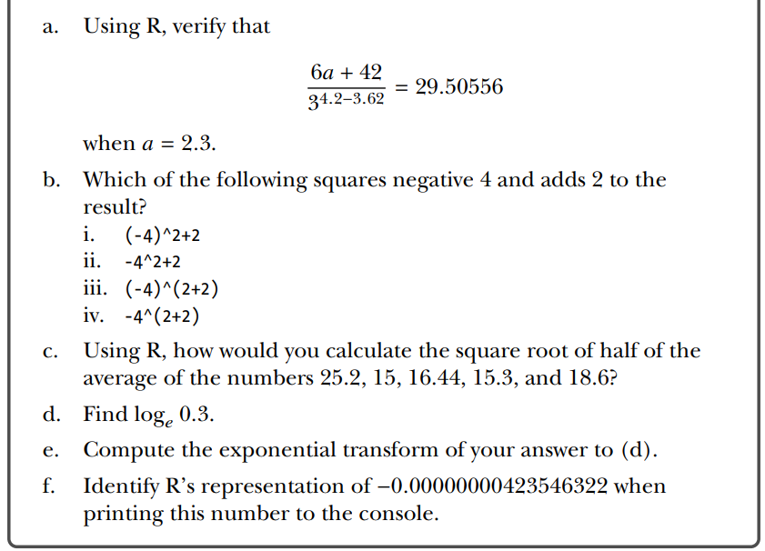
Operators in R
Classwork 2

Slide 24
Operators in R
Comparison Operators
→ Compare values and return logical values (TRUE or FALSE).
# Less than (<)
3 < 5 # Result: TRUE
5 < 3 # Result: FALSE
# Greater than or equal to (>=)
5 >= 5 # Result: TRUE
7 >= 5 # Result: TRUE
5 >= 7 # Result: FALSE
# Less than or equal to (<=)
5 <= 5 # Result: TRUE
3 <= 5 # Result: TRUE
5 <= 3 # Result: FALSE
# Equal to (==)
5 == 5 # Result: TRUE
5 == 3 # Result: FALSE
# Not equal to (!=)
5 != 3 # Result: TRUE
5 != 5 # Result: FALSE
# Greater than (>)
7 > 5 # Result: TRUE
5 > 7 # Result: FALSE
Use comparison operators to filter data frames or vectors based on conditions.
Implement logic using if statements that depend on comparisons.

Slide 25

Operators in R
Logical Operators
Logical operators are used to perform element-wise logical operations and return logical values (TRUE or FALSE).

Slide 26
Operators in R
Logical Operators
AND (& and &&)
Returns TRUE if both operands are TRUE.
The single & is used for element-wise operations, while && is used for the first element of each vector only.
# AND (& and &&)
> 5>3 & 5==3
[1] FALSE
# Element-wise AND
c(TRUE, FALSE, TRUE) & c(TRUE, TRUE, FALSE)
# Result: TRUE FALSE FALSE
# First element AND
c(TRUE, FALSE, TRUE) && c(TRUE, TRUE, FALSE)
(TRUE && FALSE) # Result: FALSE
(TRUE && TRUE) # Result: TRUE

Slide 27
Operators in R
Logical Operators
OR ( | and || )
Returns TRUE if at least one operand is TRUE.
The single | is used for element-wise operations, while || is used for the first element of each vector only.
# Example
> 5 == 3 | 5 == 5
[1] TRUE
# Element-wise OR
c(TRUE, FALSE, TRUE) | c(FALSE, TRUE, FALSE)
# Result: TRUE TRUE TRUE
# First element OR
(TRUE || FALSE) # Result: TRUE
(FALSE || FALSE) # Result: FALSE

Slide 28
Operator in R
Logical Operators
NOT (!)
→ Returns the opposite logical value of the operand.
# Example
!TRUE # Result: FALSE
!FALSE # Result: TRUE
Logical operators are essential for combining multiple conditions in R, enabling powerful data manipulation and control flow operations.

Slide 29
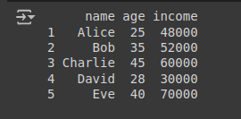
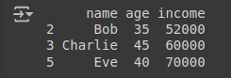
Operator in R
Classwork 3: Logical operators
https://colab.research.google.com/drive/1eyfgpWcLOe_8NNqac9B20I0eO-C0qdq-?usp=sharing
Filter this table
Age > 30
Income greater than 50000$

Slide 30
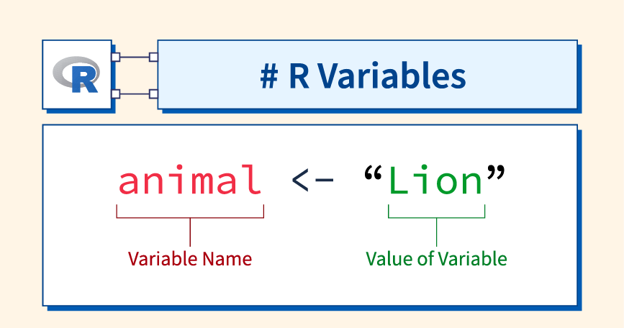
Assignment Operators
Assignment (<- or =)
Purpose: Assignment operators are used to assign values to variables in R.
# Example
# Assign values to variables
name <- "Duy"
friend = "Minh"
"Loi" -> teacher
Assignment operators are fundamental in R, enabling you to store and manipulate data efficiently.

Slide 31
Assignment Operators
# Assign a value for x
> x <- -5
> x
[1] -5
# Assign another value for x
> x = x + 1 # this overwrites the previous value of x
> x
[1] -4
# Doing math with x and assign to y
> mynumber = 45.2
> y <- mynumber*x
> y
[1] -180.8

Slide 32
Assignment Operators
Classwork 4: Assignment Operator
https://colab.research.google.com/drive/1eyfgpWcLOe_8NNqac9B20I0eO-C0qdq-?usp=sharing
Make a sentence using these variables
# Example
# Assign values to variables
name <- "Duy"
friend = "Minh"
"Loi" -> teacher

Slide 33
Operators in R
Some special values (Inf, NaN, NA, NULL)
Inf (Infinity)
Represents infinity in R.
1 / 0
[1] Inf
-1 / 0
[1] -Inf
x <- c(10, Inf, 20)
sum(x)
[1] Inf

Slide 34
Operators in R
Some special values (Inf, NaN, NA, NULL)
NaN (Not a Number)
Represents undefined or unrepresentable numerical results.
0 / 0
[1] NaN
sqrt(-1)
[1] NaN
NaN is used to indicate a value that cannot be defined mathematically.
Functions like is.nan() can be used to identify NaN values.
y <- c(1, NaN, 2)
is.nan(y)
[1] FALSE TRUE FALSE

Slide 35
Operators in R
Some special values (Inf, NaN, NA, NULL)
NA (Not Available)
Represents missing values in R.
NA can be of different types (numeric, character, etc.).
Functions like is.na() help identify missing values.
z <- c(1, 2, NA, 4)
mean(z)
[1] NA
mean(z, na.rm = TRUE)
[1] 2.333
is.na(z)
[1] FALSE FALSE TRUE FALSE

Slide 36
Operators in R
Some special values (Inf, NaN, NA, NULL)
NULL (Empty or Undefined Value)
Represents the absence of a value or an undefined value.
NULL is different from NA and NaN.
Used to indicate that an object does not exist.
my_list <- list(a = 1, b = NULL)
length(my_list)
[1] 2
print(NULL)
[1] NULL

Slide 37
Operators in R
Some special values (Inf, NaN, NA, NULL)
Special Value | Meaning | Example Usage
Inf | Positive or negative infinity | 1/0, -1/0
NaN | Undefined or unrepresentable value | 0/0, sqrt(-1)
NA | Missing value | mean(c(1, NA), na.rm=TRUE)
NULL | No value or undefined value | list(a = 1, b = NULL)

Slide 38
Data Types and Structures

Slide 39
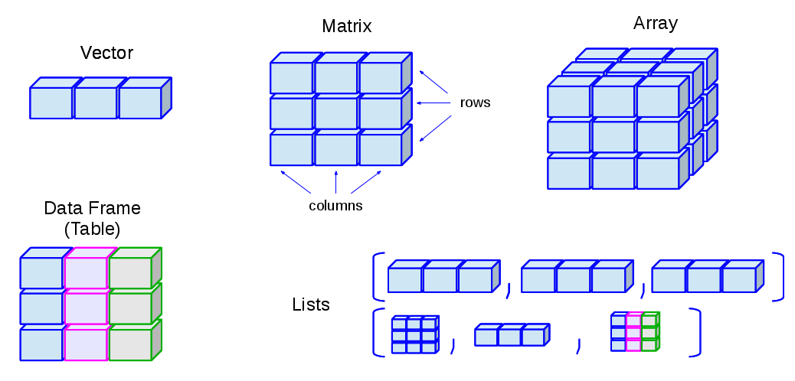
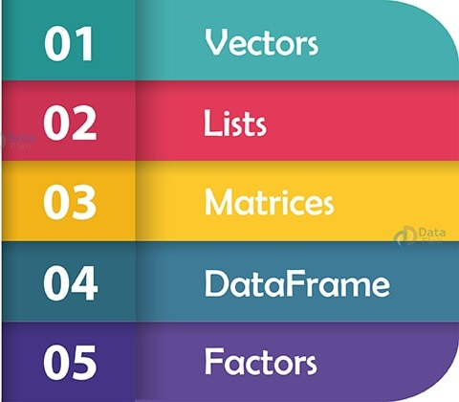
Data Types and Structures
Data structures
http://venus.ifca.unican.es/Rintro/_images/dataStructuresNew.png

Slide 40
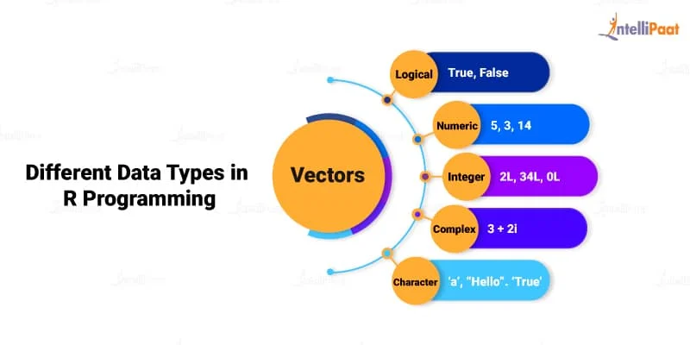
Data Types and Structures
Vector
# Numeric
numeric_vector <- c(1, 2, 3.5, 4.8, 6)
# Character
character_vector <- c("apple", "banana", "cherry")
# Logical
logical_vector <- c(TRUE, FALSE, TRUE, FALSE)

Slide 41
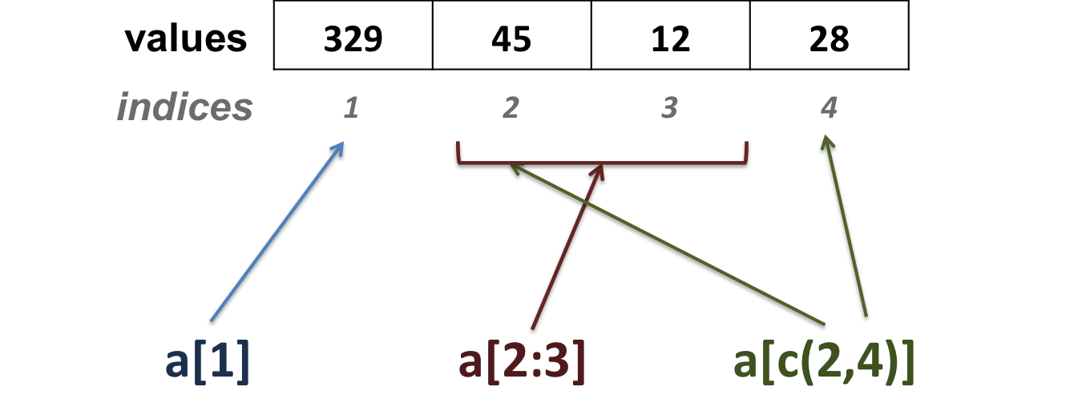
Data Types and Structures
Vector-Oriented Behavior
# Creating a vector
vector1 <- c(329, 45, 12, 28)
Vector carries out operations on multiple elements simultaneously with speed and efficiency.
This vectororiented, vectorized, or element-wise behavior is a key feature of the language

Slide 42
Vector Operation
Vector Arithmetic
Element-wise Operations:
Vector-Vector Operations
# Numeric vector
numbers <-c(1,2,3,4,5)
# Character vector
names<-c("Alice","Bob","Charlie")
# Addition
result <- numbers + 2
print(result)
[1] 3 4 5 6 7
# Multiplication
result <- numbers *2 print(result)
[1] 2 4 6 8 10
# Adding two vectors
vector1 <-c(1,2,3)
vector2 <-c(4,5,6)
result <- vector1 + vector2
print(result)
[1] 5 7 9

Slide 43
Vector Operation
Vector Indexing and Subsetting
Accessing Elements:
Logical Subsetting
# Access the second element
second_element <- numbers[2] print(second_element)
[1] 2
# Get elements greater than 3
gt_than_3 <- numbers[numbers >3] print(greater_than_three)
[1] 4 5
Subsetting:
# Get a subset of the first three elements
subset_vector <- numbers[1:3] print(subset_vector)
[1] 1 2 3

Slide 44
Vector Operation
Vector Naming
# Name the elements of the vector
names(numbers)<-c("First","Second","Third","Fourth","Fifth")
print(numbers)
[1] First Second Third Fourth Fifth # 1 2 3 4 5
Vector Type
Combining Vectors
# Get the type of the vector
vector_type <- typeof(numbers) print(vector_type)
[1] "double"
# Combine vectors
combined_vector <-c(vector1, vector2)
print(combined_vector)
[1] 1 2 3 4 5 6

Slide 45

Vector Operation
The Recycling Rule
→ How R handles operations between vectors of unequal lengths.
→ R will "recycle" the shorter vector by repeating its elements until it matches the length of the longer vector.
# Shorter vector is recycled to match the length of the longer vector
short_vector <-c(1,2)
long_vector <-c(10,20,30,40)
result <- long_vector + short_vector
print(result)
[1] 11 22 31 42

Slide 46
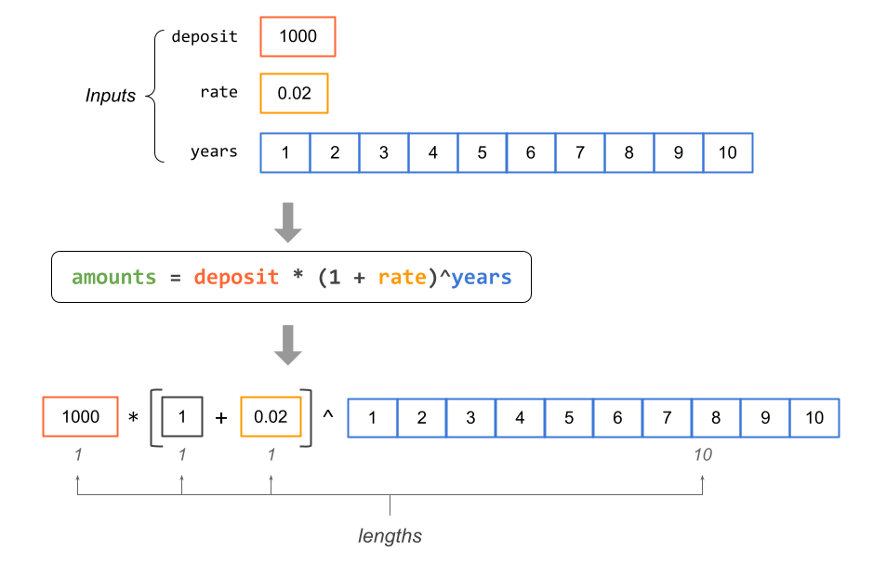
Vector Operation
The Recycling Rule
https://www.gastonsanchez.com/R-coding-basics/vectors4.html#recycling

Slide 47
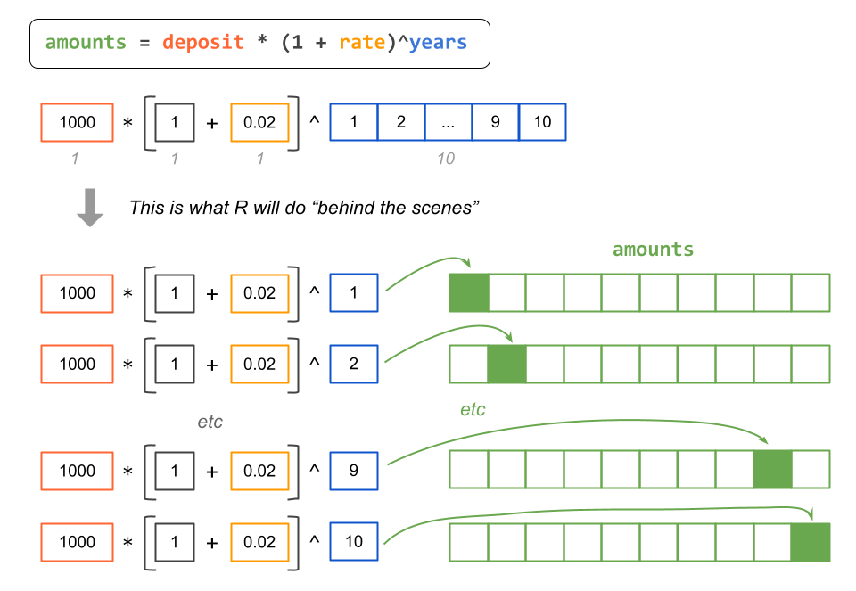
Vector Operation
The Recycling Rule
https://www.gastonsanchez.com/R-coding-basics/vectors4.html#recycling

Slide 48
Vector Operation
# Sequences with seq()
> seq(from=3, to=27, by=3)
[1] 3 6 9 12 15 18 21 24 27
# Repetition with rep()
> rep(x=1,times=4)
[1] 1 1 1 1
> rep(x=c(3,62,8.3),times=3)
[1] 3.0 62.0 8.3 3.0 62.0 8.3 3.0 62.0 8.3
# Sorting with sort()
> sort(x=c(2.5,-1,-10,3.44),decreasing=FALSE)
[1] -10.00 -1.00 2.50 3.44
> sort(x=c(2.5,-1,-10,3.44),decreasing=TRUE)
[1] 3.44 2.50 -1.00 -10.00
# Finding a Vector length with length()
> length(x=c(3,2,8,1))
[1] 4
Special functions: Sequences, Repetition, Sorting, and Lengths
Notes:
Try these:
seq(from=3,to=27,length.out=40)
foo <- 5.3
myseq <- seq(from=foo,to=(-47+1.5),by=-2.4)
myseq
myseq2 <- seq(from=foo,to=(-47+1.5),length.out=5)
myseq2
rep(x=c(3,62,8.3),each=2)
rep(x=c(3,62,8.3),times=3,each=2)

Slide 49
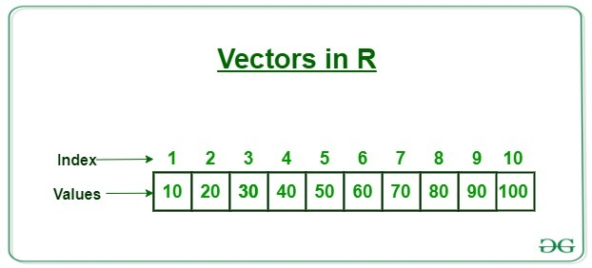
Vector Operation
Subsetting and Element Extraction
> myvec <- c(5,-2.3,4,4,4,6,8,10,40221,-8)
> length(x=myvec)
[1] 10
> myvec[1]
[1] 5
> foo <- myvec[2]
> foo
[1] -2.3
> myvec[length(x=myvec)]
[1] -8
https://www.geeksforgeeks.org/r-vector/

Slide 50
Vector Operation
Factors
Represent categorical data in R
Store both the values of the data and the corresponding levels
Unique values
# Creating a factor from a character vector
colors <-c("red","green","blue","red","green")
color_factor <- factor(colors) print(color_factor)
[1] red green blue red green
Levels: blue green red
# Specifying the order of levels
ordered_factor <- factor(colors, levels =c("red","green","blue"))
print(ordered_factor)
[1] red green blue red green
Levels: red green blue

Slide 51
Vector Operation
Classwork 5: Replicate all the Vector operation codes above

Slide 52
Matrix and array
Matrix
Definition: A matrix is a two-dimensional (2D) data structure in R where all elements are of the same data type (numeric, character, or logical).
Structure: Consists of rows and columns.
Array
Definition: An array is a multi-dimensional data structure in R that can have more than two dimensions. All elements must be of the same type.
Structure: Arrays can be thought of as matrices extended to more dimensions.

Slide 53
Matrix and array
Matrix
# Create a 3x3 numeric matrix
mat <- matrix(1:9, nrow =3, ncol =3)
print(mat)
[,1] [,2] [,3]
[1,] 1 4 7
[2,] 2 5 8
[3,] 3 6 9
Array
# Create a 3x3x2 array
arr <- array(1:18,dim=c(3,3,2))
print(arr)
, , 1
[,1] [,2] [,3]
[1,] 1 4 7
[2,] 2 5 8
[3,] 3 6 9
, , 2
[,1] [,2] [,3]
[1,] 10 13 16
[2,] 11 14 17
[3,] 12 15 18

Slide 54
Matrix
Matrix operation
# Create matrix filled by row mat_by_row <- matrix(1:9, nrow =3, byrow =TRUE)
print(mat_by_row)
[,1] [,2] [,3]
[1,] 1 2 3
[2,] 4 5 6
[3,] 7 8 9
Matrix Multiplication
# Matrix multiplication
mat_mult <- mat %*% t(mat) print(mat_mult)
[,1] [,2] [,3]
[1,] 66 78 90
[2,] 78 93 108
[3,] 90 108 126
Element-wise Operations
# Multiply matrix by 2
mat_times_two <- mat *2 print(mat_times_two)
[,1] [,2] [,3]
[1,] 2 8 14
[2,] 4 10 16
[3,] 6 12 18

Slide 55
Matrix
Subsetting Matrix
Extracting Elements:
# Extract element from 2nd row, 3rd column
element <- mat[2,3]
print(element)
[1] 8
Extracting Rows/Columns:
# Extract entire 1st row
row <- mat[1,]
print(row)
[1] 1 4 7

Slide 56
Matrix
Common Matrix Functions
Transpose
Matrix Dimensions
# Transpose a matrix
mat <- matrix(1:9, nrow=3, ncol=3)
print(mat)
[,1] [,2] [,3]
[1,] 1 4 7
[2,] 2 5 8
[3,] 3 6 9
t_mat <- t(mat)
print(t_mat)
[,1] [,2] [,3]
[1,] 1 2 3
[2,] 4 5 6
[3,] 7 8 9
# Get matrix dimensions
dim_mat <-dim(mat)
print(dim_mat)
[1] 3 3

Slide 57

Matrix
Classwork 6: Create a microbiome feature matrix
Background:
In microbiome research, data is often organized in matrix where rows represent different samples (e.g., from different patients or environmental sites) and columns represent various attributes like bacterial species, metadata (e.g., sample location, date), or calculated metrics (e.g., diversity indices).

Slide 58
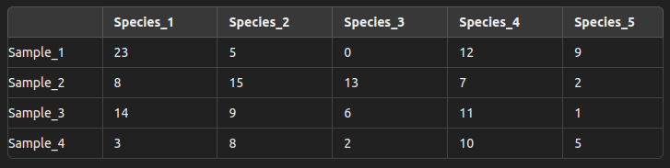
Matrix
Classwork 6: Create a microbiome feature matrix
1.1 Create a matrix named microbiome_data representing the abundance of 5 bacterial species across 4 different samples. Use the following data
microbiome_data <- matrix(c(23, 5, 0, 12, 9, 8, 15, 13, 7, 2, 14, 9, 6, 11, 1, 3, 8, 2, 10, 5), nrow = 4, byrow = TRUE)
1.2 Assign row names as "Sample_1", "Sample_2", "Sample_3", and "Sample_4", and column names as "Species_1", "Species_2", "Species_3", "Species_4", and "Species_5".

Slide 59
Matrix
Classwork 6: Create a microbiome feature matrix
Part 2: Basic Matrix Operations
2.1 Extract the abundance data for "Species_3" across all samples.
2.2 Extract the data for "Sample_2" across all species.
2.3 Calculate the total abundance for each sample. (Use rowSums function)
2.4 Calculate the average abundance for each species across all samples. (Use colMeans function)

Slide 60
Matrix
Classwork 6: Create a microbiome feature matrix
Part 3: Advanced Matrix Operations
3.1 Transpose the microbiome_data matrix to switch rows and columns.
3.2 Identify the sample with the highest abundance of "Species_1".
Hint: Use the which.max() function to find the index.
3.3 Add a new species ("Species_6") with the following abundance data: [7, 10, 3, 5].
Hint: Use the cbind() function to add a new column.

Slide 61
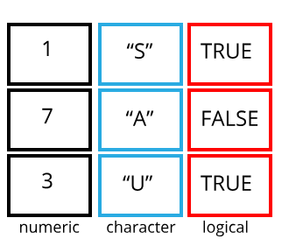
Data Frame
Definition:
A data frame is a table or a 2-dimensional array-like structure in R, where each column can contain different types of data (numeric, character, factor, etc.).
Structure:
Similar to a spreadsheet or SQL table, with rows representing observations and columns representing variables.

Slide 62
Data Frame
Creating a Data Frame
# Create a data frame with three columns
df <- data.frame(ID =1:4,
Name=c("Alice","Bob","Charlie","Diana"),
Score =c(85,92,88,76))
print(df)
ID Name Score
1 1 Alice 85
2 2 Bob 92
3 3 Charlie 88
4 4 Diana 76

Slide 63
Data Frame
Accessing Data in a Data Frame
Using $ to Access Columns:
# Access the 'Name'
columnnames<- df$Name print(names)
[1] "Alice" "Bob" "Charlie" "Diana"
Using Indexing
# Access the element in the 2nd row, 3rd column
element <- df[2,3] print(element)
[1] 92

Slide 64
Data Frame
Common Data Frame Operations
Adding a New Column
Subsetting Data Frames:
# Add a new column 'Passed'
df$Passed <- df$Score >80 print(df)
ID Name Score Passed
1 1 Alice 85 TRUE
2 2 Bob 92 TRUE
3 3 Charlie 88 TRUE
4 4 Diana 76 FALSE
# Subsetting a dataframe with condition
high_scores <- df[df$Score >80,]
print(high_scores)
ID Name Score Passed
1 1 Alice 85 TRUE
2 2 Bob 92 TRUE
3 3 Charlie 88 TRUE

Slide 65
Data Frame
Combining Data Frames
Row Binding
Column Binding
# Combine data frames by adding rows
df_new <- data.frame(ID=5,
Name="Eve",
Score=90)
combined_df <- rbind(df, df_new)
print(combined_df)
ID Name Score Passed
1 1 Alice 85 TRUE
2 2 Bob 92 TRUE
3 3 Charlie 88 TRUE
4 4 Diana 76 FALSE
5 5 Eve 90 TRUE
# Combine data frames by adding columns
extra_info <- data.frame(Age=c(23,25,22,21,24))
full_df <- cbind(combined_df,
extra_info)
print(full_df)
ID Name Score Passed Age
1 1 Alice 85 TRUE 23
2 2 Bob 92 TRUE 25
3 3 Charlie 88 TRUE 22
4 4 Diana 76 FALSE 21
5 5 Eve 90 TRUE 24

Slide 66
Data Frame
Viewing and Inspecting Data Frames
# Viewing data
View(df)
# Explore the structure of the data
str(df)
'data.frame': 4 obs. of 4 variables:
$ ID : int 1 2 3 4
$ Name : chr "Alice" "Bob" "Charlie" "Diana"
$ Score : num 85 92 88 76
$ Passed: logi TRUE TRUE TRUE FALSE

Slide 67
Data Frame
Summary Statistics
To get a summary of each column.
summary(df)
ID Name Score Passed
Min. :1.00 Length:4 Min. :76.00 Mode :logical
1st Qu.:1.75 Class :character 1st Qu.:82.75 FALSE:1
Median :2.50 Mode :character Median :86.50 TRUE :3
Mean :2.50 Mean :85.25
3rd Qu.:3.25 3rd Qu.:89.00
Max. :4.00 Max. :92.00

Slide 68
Data Frame
Subsetting and Filtering Data
Subset Rows Based on Conditions
Select Specific Columns
# Get rows where Score is greater than 80
high_scores <- df[df$Score >80,]
print(high_scores)
ID Name Score Passed
1 1 Alice 85 TRUE
2 2 Bob 92 TRUE
3 3 Charlie 88 TRUE
# Select only the 'Name' and 'Score' columns
name_score <- df[,c("Name","Score")] print(name_score)
Name Score
1 Alice 85
2 Bob 92
3 Charlie 88
4 Diana 76

Slide 69
Data Frame
Adding and Modifying Columns
Add a New Column
Modify an Existing Column
# Add a column indicating if the score is above average
df$Above_Average <-
df$Score > mean(df$Score)
print(df)
ID Name Score Passed Above_Average
1 1 Alice 85 TRUE FALSE
2 2 Bob 92 TRUE TRUE
3 3 Charlie 88 TRUE TRUE
4 4 Diana 76 FALSE FALSE
# Adjust the score by adding 5 points to each student
df$Score <- df$Score + 5
print(df)
ID Name Score Passed Above_Average
1 1 Alice 90 TRUE FALSE
2 2 Bob 97 TRUE TRUE
3 3 Charlie 93 TRUE TRUE
4 4 Diana 81 FALSE FALSE

Slide 70
Data Frame
Sorting Data Frames
Sort by a Single Column
Sort by Multiple Columns
# Sort the data frame by 'Score' in descending order
df_sorted <- df[order(-df$Score),] print(df_sorted)
ID Name Score Passed Above_Average
2 2 Bob 97 TRUE TRUE
3 3 Charlie 93 TRUE TRUE
1 1 Alice 90 TRUE FALSE
4 4 Diana 81 FALSE FALSE
# Sort by 'Passed' (descending) and then by 'Score' (ascending)
df_sorted_multi <- df[order(-df$Passed, df$Score),]
print(df_sorted_multi)
ID Name Score Passed Above_Average
1 1 Alice 90 TRUE FALSE
3 3 Charlie 93 TRUE TRUE
2 2 Bob 97 TRUE TRUE
4 4 Diana 81 FALSE FALSE

Slide 71
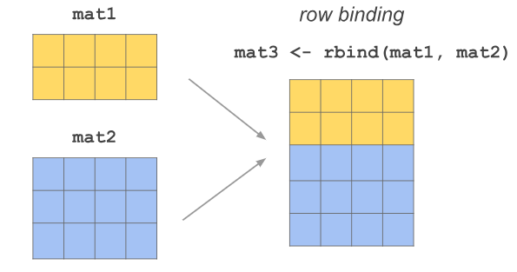
Data Frame
Combining Data Frames
Row Binding
# Bind new dataframe rows to an existed one
new_students <- data.frame(ID = 5,
Name = "Eve",
Score = 89,
Passed = TRUE,
Above_Average = FALSE)
df_combined <- rbind(df, new_students)
print(df_combined)
ID Name Score Passed Above_Average
1 1 Alice 90 TRUE FALSE
2 2 Bob 97 TRUE TRUE
3 3 Charlie 93 TRUE TRUE
4 4 Diana 81 FALSE FALSE
5 5 Eve 89 TRUE FALSE
https://www.gastonsanchez.com/intro2cwd/arrays.html

Slide 72
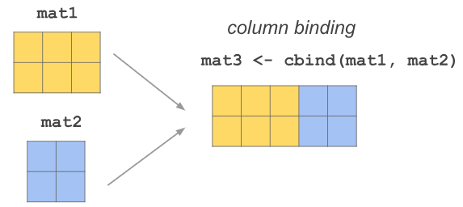
Data Frame
Combining Data Frames
Column Binding
# Add a new column for student
Age ages <- data.frame(Age = c(23,25,22,21,24))
df_with_age <- cbind(df_combined, ages)
print(df_with_age)
ID Name Score Passed Above_Average Age
1 1 Alice 90 TRUE FALSE 23
2 2 Bob 97 TRUE TRUE 25
3 3 Charlie 93 TRUE TRUE 22
4 4 Diana 81 FALSE FALSE 21
5 5 Eve 89 TRUE FALSE 24
https://www.gastonsanchez.com/intro2cwd/arrays.html

Slide 73
Data Frame
Removing or Renaming Columns
Remove a Column
Rename a Column
# Remove the 'Passed' column
df_no_passed <- df[,!(names(df)%in%"Passed")]
print(df_no_passed)
ID Name Score Above_Average
1 1 Alice 90 FALSE
2 2 Bob 97 TRUE
3 3 Charlie 93 TRUE
4 4 Diana 81 FALSE
# Rename 'Score' to 'Final_Score'
names(df)[names(df)=="Score"]<-"Final_Score"
print(df)
ID Name Final_Score Passed Above_Average
1 1 Alice 90 TRUE FALSE
2 2 Bob 97 TRUE TRUE
3 3 Charlie 93 TRUE TRUE
4 4 Diana 81 FALSE FALSE

Slide 74
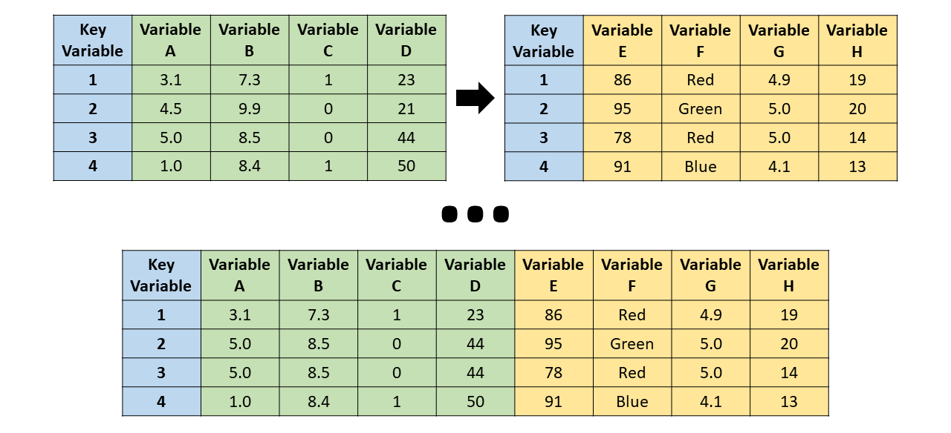
Data Frame
Merging Data Frames
https://rforhr.com/join.html

Slide 75
Data Frame
Merging Data Frames
# Merge two data frames by the 'ID' column
df_info <- data.frame(ID =1:4,
Gender = c("F","M","M","F"))
df_merged <- merge(df, df_info, by ="ID")
print(df_merged)
ID Name Score Passed Above_Average Gender
1 1 Alice 90 TRUE FALSE F
2 2 Bob 97 TRUE TRUE M
3 3 Charlie 93 TRUE TRUE M
4 4 Diana 81 FALSE FALSE F

Slide 76
Data Frame
Other Key Functions
nrow(df): Number of rows.
ncol(df): Number of columns.
dim(df): Dimensions (rows, columns).
names(df): Column names.

Slide 77
Data Frame
Classwork 7: Replicate all the dataframe operation codes above

Slide 78
Data Frame
Classwork 8: Working with Microbiome Data Frames in R
Exercise Objectives:
Create and manipulate a data frame representing microbiome data.
Perform basic operations such as subsetting, filtering, and summarizing data.

Slide 79
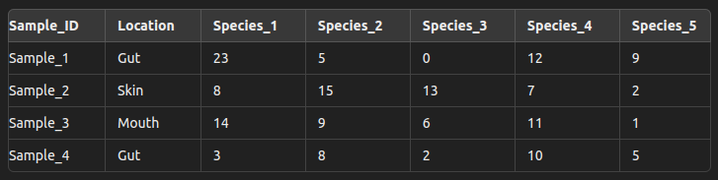
Data Frame
Classwork 8: Working with Microbiome Data Frames in R
Part 1: Creating a Data Frame
1.1 Create a data frame named microbiome_df containing the following data:
microbiome_df <- data.frame(
Sample_ID = c("Sample_1", "Sample_2", "Sample_3","Sample_4"),
Location = c("Gut", "Skin", "Mouth", "Gut"),
Species_1 = c(23, 8, 14, 3),
Species_2 = c(5, 15, 9, 8),
Species_3 = c(0, 13, 6, 2),
Species_4 = c(12, 7, 11, 10),
Species_5 = c(9, 2, 1, 5) )
1.2 Display the structure of the data frame to understand its composition.

Slide 80
Data Frame
Classwork 8: Working with Microbiome Data Frames in R
Part 2: Basic Data Frame Operations
2.1 Extract the data for "Sample_3" (all columns).
2.2 Extract the data for Species_2 across all samples.
2.3 Calculate the total bacterial abundance for each sample (sum of Species_1 to Species_5).

Slide 81
Data Frame
Classwork 8: Working with Microbiome Data Frames in R
Part 3: Filtering and Subsetting
3.1 Filter the data frame to include only samples from the "Gut" location.
3.2 Subset the data frame to include only "Sample_ID", "Location", and "total_abundance" columns.
Part 4: Summarizing Data
4.1 Calculate the mean abundance for "Species_1" across all samples.
4.2 Find the sample with the highest total abundance.
4.3 Count the number of samples from each location.

Slide 82
Data Frame
Classwork 8: Working with Microbiome Data Frames in R
Part 5: Adding New Data
5.1 Add a new column to the data frame representing a calculated metric, such as the ratio of Species_1 to total_abundance.
5.2 Add a new sample to the data frame with the following information:
Sample_ID: "Sample_5"
Location: "Skin"
Species_1 to Species_5: [6, 12, 4, 8, 3]

Slide 83
List
Definition:
A list is a versatile data structure in R that can contain elements of different types (vectors, data frames, functions, etc.).
Structure:
Lists can hold any number of elements, each of which can be of a different type and length.

Slide 84
List
$Name
[1] "Alice"
$Age
[1] 25
$Scores
[1] 85 92 88
$Passed
[1] TRUE
$Info
Subject Grade
1 Math A
2 Science B
Creating a List
# Create a list with different types of elements
my_list <- list(Name = "Alice",
Age = 25,
Scores = c(85, 92, 88),
Passed = TRUE,
Info = data.frame(Subject = c("Math", "Science"), Grade = c("A", "B")) )
print(my_list)

Slide 85
List
Accessing Elements in a List
Using $ or [[ ]]:
# Access the first score
first_score <- my_list[["Scores"]][1]
print(first_score)
[1] 85
# Access the 'Grade' column in the 'Info' data frame
grades <- my_list$Info$Grade
print(grades)
[1] "A" "B"
# Access the 'Name' element
name <- my_list$Name
print(name)
[1] "Alice"
# Access the 'Scores' element
scores <- my_list[["Scores"]]
print(scores)
[1] 85 92 88

Slide 86
List
Modifying Lists
Adding Elements
Removing Elements
# Add a new element to the list
my_list$City <- "New York"
print(my_list)
# Remove the 'Passed' element
my_list$Passed <- NULL
print(my_list)
Updating Existing Elements
# Update the 'Age' element
my_list$Age <- 26
print(my_list$Age)
[1] 26

Slide 87
List
$Name
[1] "Alice"
$Age
[1] 25
$Scores
[1] 85 92 88
$Passed
[1] TRUE
$Info
Subject Grade
1 Math A
2 Science B
$Hobbies
[1] "Reading" "Traveling"
Combining and Splitting Lists
Combining Lists
# Combine two lists
another_list <- list(Hobbies = c("Reading", "Traveling"))
combined_list <- c(my_list, another_list)
print(combined_list)

Slide 88
List
Unlisting a List
# Flatten the list into a vector
unlisted <- unlist(my_list)
print(unlisted)
Name Age Scores1 Scores2 Scores3
"Alice" "25" "85" "92" "88"
Passed Info.Subject1 Info.Subject2 Info.Grade1 Info.Grade2
"TRUE" "Math" "Science" "A" "B"

Slide 89
List
List Operations
Length of a List
# Get the number of elements in the list list_length <- length(my_list) print(list_length) # Output: 5
Looping Through Lists
# Loop through list elements
for (element in my_list) {
print(element)
}

Slide 90
List
When to Use Lists
Heterogeneous Data: When you need to store elements of different types or structures.
Complex Objects: When storing outputs from models, results from multiple analyses, or data that doesn't fit neatly into a vector or data frame.

Slide 91
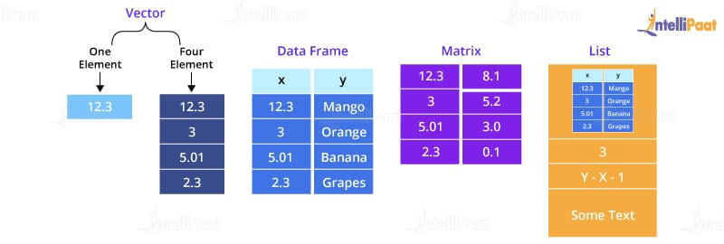
Data structure summary

Slide 92
Save data
Why Save Data?
Preservation: Store your processed data for future use.
Sharing: Easily share data with others or transfer between projects.
Efficiency: Avoid re-running expensive data processing steps.

Slide 93
Save data
Common Functions to Save Data
save()
Save one or more R objects (e.g., data frames, lists) to an R data file (.RData or .rda).
save(object1, object2, file = "mydata.RData")
save(df, list_of_results, file = "results.RData")
saveRDS()
Save a single R object to an RDS file (.rds).
saveRDS(df, file = "dataframe.rds")

Slide 94
Save data
Common Functions to Save Data
write.csv()
Save a data frame as a CSV file.
write.csv(df, file = "results.csv", row.names = FALSE)
write.table()
Save data to a text file with more control over formatting.
write.table(df, file = "results.txt", sep = "\t", row.names = FALSE)

Slide 95
Save data
Loading Saved Data
load(): Load an R data file (.RData or .rda)
load("mydata.RData")
readRDS(): Load an RDS file.
df <- readRDS("dataframe.rds")

Slide 96
R functions

Slide 97
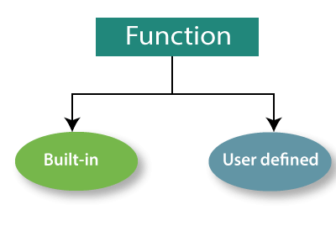
R Functions
Useful Built-in function
Create an R function
https://www.statmethods.net/management/functions.html
https://iqss.github.io/dss-workshops/R/Rintro/base-r-cheat-sheet.pdf

Slide 98
R Functions
Useful Built-in function
Data Manipulation
subset(): Extract subsets of data.
merge(): Combine data frames by common columns or row names.
apply(): Apply a function over the margins of an array or matrix.
tapply(): Apply a function over subsets of a vector.
reshape(): Reshape data between wide and long formats.
cut(): Divide continuous variables into intervals.
aggregate(): Compute summary statistics over subsets of data.
Statistical Analysis
summary(): Provide a summary of an object.
cor(): Calculate correlation between variables.
lm(): Fit linear models.
table(): Create a contingency table of counts.

Slide 99
R Functions
Useful Built-in function
Data Cleaning
na.omit(): Remove missing values from an object.
is.na(): Identify missing values.
duplicated(): Identify duplicate elements.
Data Visualization
plot(): Generic X-Y plotting.
hist(): Create a histogram.
boxplot(): Create a boxplot.
pairs(): Create a matrix of scatterplots.

Slide 100
R Functions
Useful Built-in function
Utility Functions
str(): Display the structure of an R object.
paste(): Concatenate strings.
seq(): Generate a sequence of numbers.
rep(): Repeat elements of a vector.

Slide 101
R Functions
Apply function and its relatives
Purpose: To demonstrate the use of apply functions for efficient data manipulation in microbiome research.
Key Functions: apply(), lapply(), sapply(), tapply(), mapply()
Advantages of Using Apply Functions
Efficiency: Faster execution by avoiding explicit loops.
Readability: Clean and concise code.
Vectorization: Leverages R's strength in vectorized operations.

Slide 102
R Functions
Apply function and its relatives
apply()
Parameters:
X: Array or matrix.
MARGIN: An integer vector indicating which margins should be "retained". 1 indicates rows, 2 for columns.
FUN: The function to be applied.
apply(X, MARGIN, FUN, ...)
# Compute row sums of a matrix
matrix_data <- matrix(1:9, nrow = 3)
apply(matrix_data, 1, sum) # Sums of rows

Slide 103
R Functions
Apply function and its relatives
lapply()
Usage: Apply a function over elements in a list, returning a list.
lapply(X, FUN, ...)
Parameters:
X: List or vector.
FUN: The function to apply.
# Compute length of each string in a list
string_list <- list("apple", "banana", "cherry")
lapply(string_list, nchar)

Slide 104
R Functions
Apply function and its relatives
sapply()
Usage: Simplified version of lapply() that tries to simplify the result to a vector or matrix.
sapply(X, FUN, ..., simplify = TRUE)
Parameters:
X: List or vector.
FUN: The function to apply.
# Compute square of each number
numbers <- 1:5
sapply(numbers, function(x) x^2)

Slide 105
R Functions
Apply function and its relatives
tapply()
Usage: Apply a function over subsets of a vector, grouped by some other vector, usually a factor.
Parameters:
X: A vector.
INDEX: A factor or a list of factors (the grouping variable).
FUN: The function to apply.
tapply(X, INDEX, FUN, ..., simplify = TRUE)
# Calculate mean weight by group
weights <- c(50, 60, 65, 70)
group <- factor(c("Male", "Female", "Female", "Male"))
tapply(weights, group, mean)

Slide 106
R Functions
Create an R function
What is a Function?
Definition: A function in R is a block of code designed to perform a specific task. It can take inputs, process them, and return outputs.
Purpose: Functions allow for code reuse, organization, and abstraction of complex operations.

Slide 107
R Functions
Create an R function
Basic Structure
function_name <- function(arg1, arg2, ...) {
# Code block
result <- arg1 + arg2 # Example operation
return(result) # Return the result
}
Explanation:
function_name: Name of your function.
function: Keyword to define a function.
arg1, arg2, ...: Arguments or parameters the function accepts.
{}: Curly braces enclose the body of the function.
return(result): Specifies what the function should output.

Slide 108
R Functions
Example: Creating a Simple Function
Sum of Two Numbers
sum_two_numbers <- function(a, b) {
result <- a + b
return(result)
}
# Using the function
sum_two_numbers(5, 3)
[1] 8

Slide 109
R Functions
Default Arguments
If no argument is provided, the function uses the default value.
# Setting Default Values
greet <- function(name = "World") {
message <- paste("Hello,", name)
return(message)
}
# Calling the function
greet()
[1] "Hello, World"
greet("Duy")
[1] "Hello, Duy"

Slide 110
R Functions
Returning Multiple Values
A list is used to return multiple values from a function.
# Using a List
stats <- function(x) {
mean_val <- mean(x)
sd_val <- sd(x)
return(list(mean = mean_val, sd = sd_val))
}
# Calling the function
result <- stats(c(1, 2, 3, 4, 5))
print(result$mean)
[1] 3
print(result$sd)
[1] 1.581139

Slide 111
R Functions
Scope of Variables
Local vs Global Variables
my_function <- function(x) {
y <- x + 1 # 'y' is a local variable
return(y)
}
y <- 10 # 'y' is a global variable
result <- my_function(5)
print(y)
[1] Output: 10
#(global 'y' is unchanged)
Variables defined inside a function are local to that function and do not affect global variables.

Slide 112
R Functions
Benefits of Using Functions
Modularity: Break down complex tasks into smaller, manageable pieces.
Reusability: Write code once and reuse it multiple times.
Maintainability: Easier to debug and update code.
Abstraction: Hide complex logic behind simple function calls.
Best Practices
Clear Naming: Use descriptive names for functions and arguments.
Documentation: Comment your functions and use # to explain what each part does.
Error Handling: Validate inputs and handle potential errors inside your functions.

Slide 113
END

